Slide 1
Introduction to Research

Slide 2
Research:
An organized and systematic way of finding answers to questions.
- A systematized effort to gain new knowledge (Redman & Mory, )
Input
Process
Output

Slide 3
Research Goals (Zulueta & Costales, 2003):
Discover new knowledge
Provide solution to existing problem
Improve or develop new products
Satisfy research curiosity
Verify existing knowledge

Slide 4
Research Goals (Zulueta & Costales, 2003):
Improve quality of life
Promote health and prolong life
Basis for decision making
Acquire deeper understanding about a topic

Slide 5
Research Characteristics (Zulueta & Costales, 2003):
Empirical
Logical
Cyclical
Replicability
Critical

Slide 6
Based on direct experience or observation. Collection of data relies on practical experience without benefit of the scientific knowledge or theory.
Experiential, observed
Observable experience
First hand
Practical
Realistic
theoretical
Empirical

Slide 7
Based on valid procedures and principles. Scientific investigation is done in an orderly manner, so that the researcher has confidence in the results.
Logical examination of the procedure used in the research enables the researcher to draw valid conclusions
Logic of valid research makes it important for decision making
Characterized by carefully designed procedures
Objective and logical applying every possible test to validate the data collected and conclusions reached
Logical / analytical

Slide 8
Starts with a problem and ends with a problem.
After completing the study, researcher states his findings, and draws conclusion and recommendations.
From the recommendations, many problems may crop up as other subjects for potential study.
Cyclical

Slide 9
Research design and procedures are replicated to enable the researcher to arrive at valid and conclusive results.
Similarities and differences of replicated researches can be compared.
The more replicated there are the more valid and conclusive the result would be
Replicability

Slide 10
Research exhibits careful and precise judgment.
A quest for answers to unsolved problems requiring patience, and careful recording and reporting.
Because of the level of confidence used , researcher is confident in his interpretation whether the result is significant or insignificant; or whether to reject or accept the hypothesis.
Critical

Slide 11
Characteristics of Research (Kathaian, 2016)
directed towards the solution of a problem
based upon observable experience or empirical evidence
demands accurate observation and description
involves gathering new data from primary sources or using existing data for a new purpose
Research activities are characterized by carefully designed procedures

Slide 12
requires expertise i.e., skill necessary to carryout investigation, search the related literature and to understand and analyze the data gathered
objective and logical – applying every possible test to validate the data collected and conclusions reached.
involves the quest for answers to unsolved problems
courage.
characterized by patient and unhurried activity
carefully recorded and reported.
Characteristics of Research

Slide 13
Research Classification:
According to the Philippine Council for Advanced Science and Technology Research and Development (PCASTRD), classifications based on purpose maybe (Catane, 2000):
Basic Research
Applied Research
Developmental Research

Slide 14
Undertaken for the sake of knowledge without any intention to apply it in practice
Undertaken out of intellectual curiosity or for the pleasure of learning.
Not necessarily problem oriented
Done for the development of theories and principles
Involves developing and testing theories and hypotheses of specialized concepts (Bailey, 1994)
Basic Research
Fundamental Research

Slide 15
Known as action research, cost benefit analysis, evaluation research
Carried out to find solution to a real life problem, seek to solve practical problems
Directed towards practical application of knowledge
Aims at finding the explanation for certain problems that stem from the situation
It may support, modify, revise, or provide a new theory.
Entails large scale studies with subsequent data collection problems
Applied Research

Slide 16
Systematic work on existing knowledge gained to produce new materials, products and devices
Installing new processes, systems and services
Improve already produced or installed products, processes, systems, services, devices
Developmental Research

Slide 17
The Thesis
Major project of BSCS students
Written document produced
Includes
defining a topic,
researching literature and related studies,
carrying out original research,
writing up results, and
presenting results orally.

Slide 18
Thesis opens up opportunity to:
Pull materials learned and use it to solve problems
Produce scientific and technical knowledge
Manage people and other resources
Communicate with experts and non-expert audiences

Slide 19
Deepen understanding of social and ethical issues in CS and ICT
Distinguish oneself from graduates from other schools when applying to graduate school and employers.

Slide 20
In essence, the thesis project should involved
design and development of a device, process, or system (or a part of one of those)
justifying all elements of the design,
proving theoretically and/or empirically the adequacy of the design.
also includes the design of computer programs.

Slide 21
Topic Proposals
Algorithms and Data Structures – formal processes used for computation, and the efficiency of these processes (algorithms) and the organization and storage of data (data structure).

Slide 22
Topic Proposals
2. Theory of Computation/ Computational complexity – fundamental bounds (esp. time and storage space) on computations

Slide 23
Topic proposal
Programming Languages and Compilers – ways of efficiently translating algorithms form one form to another (compiler) and formal languages for expressing algorithms and the properties of these languages (programming languages)

Slide 24
Topic proposal
4. Operating Systems – systems for managing computer programs and data structures

Slide 25
Topic proposal
Communications and Security – algorithms and protocols for reliably communicating data across long distances (networking and communication) and algorithms for protecting private data and systems (security).

Slide 26
Topic proposal
6. Artificial Intelligence – implementation and study of systems that exhibit an autonomous intelligence or behavior of their own.

Slide 27
Topic proposal
Databases and Data Mining –
the process of sorting through large amounts of data and picking out relevant information (data mining)

Slide 28
Topic proposal
Systems and Software Engineering – the process of designing, developing, and testing programs

Slide 29
Topic proposal
Computer Graphics and Computer Vision
– algorithms both for generating visual images synthetically and for integrating or altering visual and spatial information sampled from the real world (computer graphics) and algorithms for extracting three dimensional objects from a two dimensional picture (computer vision)

Slide 30
Topic proposal
Scientific Computing – algorithms for use in the sciences, especially (but not exclusively) biology (as in bioinformatics), physics, and chemistry (may include concurrent, parallel and distributed systems)

Slide 31
Research Methods
Experimental Research Method (Exploratory or Developmental)
Descriptive Research Method
Quasi-Experimental Research Method

Slide 32
Researcher manipulates the variable to arrive at conclusions or else to come across findings
Main focus is testing the hypothesis
Allows researcher to find causality
Answers the question why
Experimental Research

Slide 33
Research that makes an attempt to comprehend the different characteristics of the study group or a phenomenon.
Only identifies behavior and describes the behavior and the participant
Its main focus is to describe the population through identifying characteristics.
Provides insights on data using statistical analysis
Does not stress on causality
Answers the question what
Descriptive Research

Slide 34
Quasi experimental Research

Slide 35
Professional and Ethical Responsibility of the student:
Be truthful in everything you say and write by accurately representing the views of others (e.g. citing properly the sources), reporting methods and findings fully, interpreting data accurately, and explicitly addressing weaknesses or flaws as well as strengths in the research work.

Slide 36
Professional and Ethical Responsibility of the student:
Obtain and use information honestly by documenting all information and ideas from others, taking credit only for work done, and giving credit to others for the work they do.

Slide 37
Professional and Ethical Responsibility of the student:
Obtain and use resources for their intended purpose by explaining the purpose of funding, equipment, advice, or other resources for which the student ask permission to use them, using only resources to which the student are entitled or receive permission, and using those resources as intended.

Slide 38
Professional and Ethical Responsibility of the student:
Clarify with collaborators who owns any work products (data or designs), and how those products may be used.

Slide 39
THESIS CLASS :
COMP 4163 – Fundamentals of Research (3 units/3 hours)
and
COMP 4173 – Thesis Writing (3 units/3 hours) under 2010 Curriculum). COSC 4013

Slide 40
COMP 4163
will consist of
defining a topic,
researching and reviewing literatures,
identifying the methods best suited for collecting and analyzing data
Developing the tool
Proposing the thesis project to the Thesis Defense Panel

Slide 41
Purpose clearly defined
Detailed research process
Research design thoroughly planned
High ethical standards applied
Limitations frankly revealed
Adequate analysis for decision maker’s needs
Findings presented unambiguously
Conclusion justified
Researcher’s experience reflected
Criteria of a good Research

Slide 42
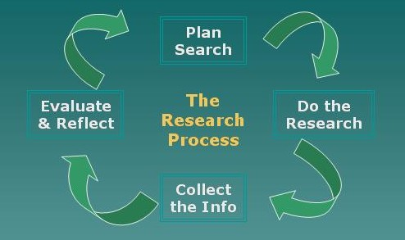
Fig. 1 The inspiration for the Research process model image below was the reflective model from: Edwards S. Bruce C. Reflective Internet Searching, an Action Research Model." In: Action Learning, Action Research and Process Management, Theory, Practice Praxis. Action Research Unit, Griffith University. 5th World Congress of Action Learning, Action Research and Process Management, University of Ballarat, Victoria, September, pp. 141-152. Cited in: Bruce, Christine Susan. "Information Literacy as a Catalyst for Educational Change: A Background Paper." U.S. National Commission on Libraries and Information Science, 2006.

Slide 43
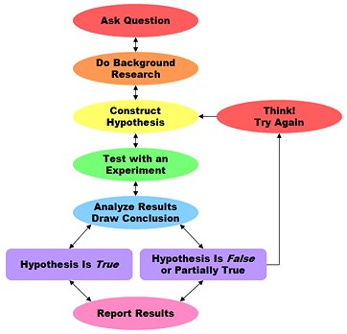

Slide 44
The following five phases outline a simple and effective strategy for conducting effective research (Hanacek, n.d.) :
I. The conceptual phase
II. Phase of construction of research design
III. Empiric phase
IV. Analytic phase
V. Disseminative phase

Slide 45
Research Process (Kothari, 2004)
I. Define Research Problem
II. Review the Literature
(review concepts and theories, review previous research findings)
III. Formulate Hypotheses
IV. Prepare the Research Design
Collect data
Analyze data
Interpret and Report Data

Slide 46
Research Structure in Layman’s term (https://www.uq.edu.au/student-services/phdwriting/phfaq05.html)
Why am I doing it? | Introduction Significance
What is known? What is unknown? | Review of research Identifying gaps
What do I hope to discover? | Aims
How am I going to discover it? | Methodology
What have I found? | Results
What does it mean? | Discussion
So what? What are the possible applications or recommendations? What contribution does it make to knowledge? What next? | Conclusions

Slide 47
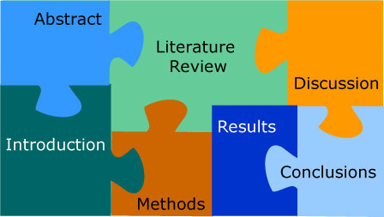
Thesis Structure

Slide 48
Thesis Problem
What is the PROBLEM you are trying to solve? Or what is the research QUESTION you are trying to answer?
Why is this problem/question worth solving/asking? Who would care?
How have other people in the past tried to solve/answer it?

Slide 49
Thesis Problem
What is your NEW approach to solving/answering this problem? Or what improvement are you making on an existing solution?
How do you prove that the solution you came up with is a GOOD solution?
How can you demonstrate that your solution works?

Slide 50
Assignment

Slide 51
Assignment
Assignment for July 4, 2017
Read the following reports on Ethics of Research.
Ethics in Research:
Research Ethics by Prashant V. Kamat
https://www3.nd.edu/~pkamat/pdf/ethics.pdf
Five Principles for Research Ethics by Deborah Smith
http://www.apa.org/monitor/jan03/principles.aspx
Ethics in Research
http://libguides.library.cityu.edu.hk/researchmethods/ethics
What is Ethics in Research & Why is it Important by David B. Resnik
https://www.niehs.nih.gov/research/resources/bioethics/whatis/
Ethical Dilemmas in Scientific Research and Professional Integrity by John Banja
http://www.actsi.org/discovery/ethics-center.html

